Slide 1
Auto Pilot
Task 6

Slide 2
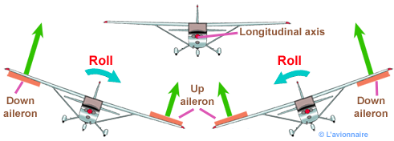
Lateral Control
The rule of the lateral autopilot is to control the motion of the airplane in the lateral-directional plane, it controls the rudder & aileron to achieve a coordinated turn
What is coordinated turn ??

Slide 3
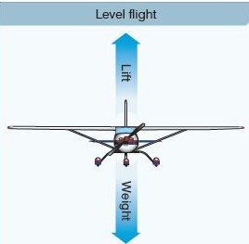
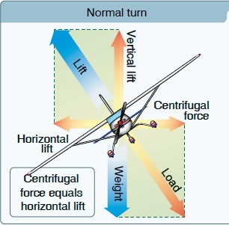
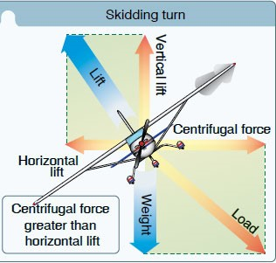
coordinated turn We may call it “zero-lateral acceleration turn”
In terms of mechanics
Normal flight
Medium banked turn
Steep banked turn

Slide 4
coordinated turn
In terms of aerodynamics
When lift increases in one of the wings the drag also increases
On that wing resulting in “adverse yaw phenomenon”
To overcome this phenomenon we need rudder input

Slide 5
coordinated turn
In terms of aerodynamics
The coordinated turn is a maneuver in which the airplane’s heading angle is changed (airplane turns) without “slipping or skidding”, i.e. the side slip angle (β = 0). note: skidding is having +ve sideslip angle (β>0) while slipping is having -ve sideslip angel (β<0)

Slide 6
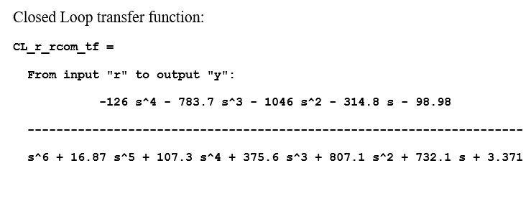
“Yaw damper” for the Dutch roll mode
Design

Slide 7
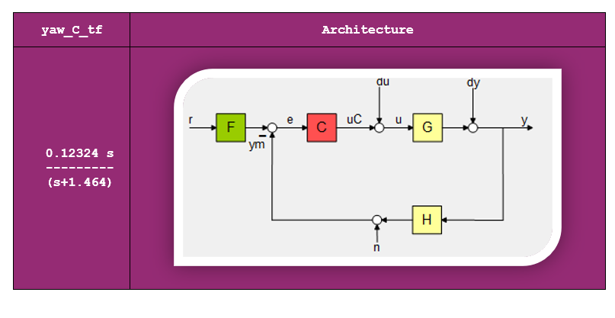
“Yaw damper” for the Dutch roll mode
Design

Slide 10

Test The “Yaw damper” controllers on the full state space model

Slide 11
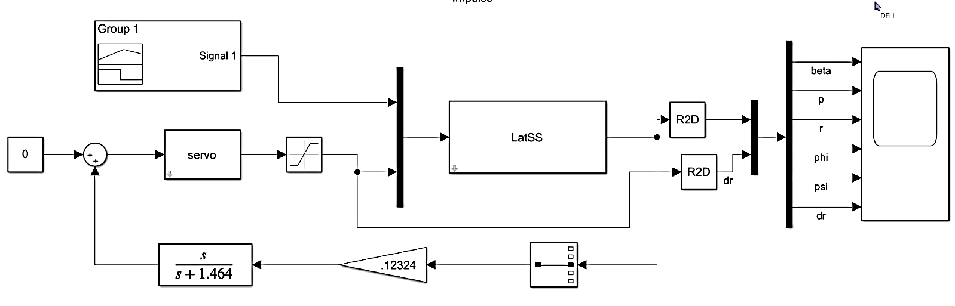
Simulink Test

Slide 12
Test Result

Slide 13
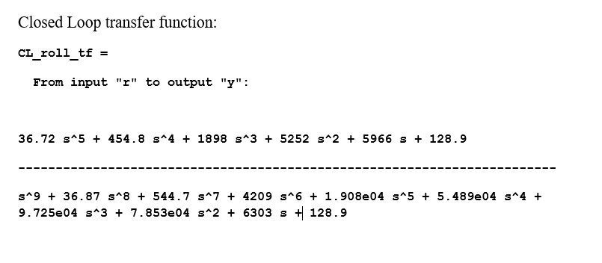
Roll Controller

Slide 14
Roll Controller
Design

Slide 15
Response

Slide 16
Control Action

Slide 17
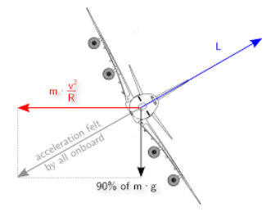
Coordination

Slide 18
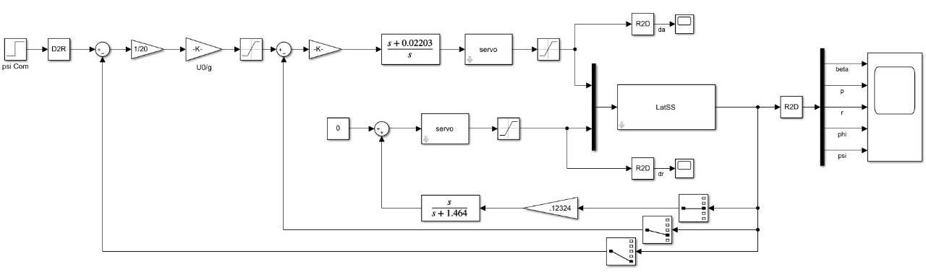
Lateral controller Test with Simulink

Slide 19
Result

Slide 20
Thanks

